Slide 1
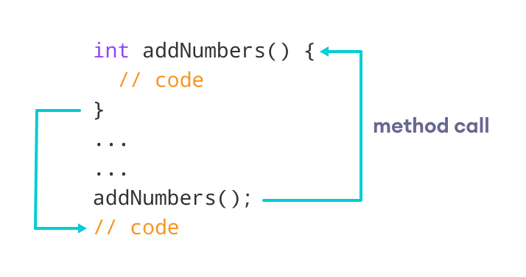
Java Methods

Slide 2
A method is a block of code which only runs when it is called.
You can pass data, known as parameters, into a method.
Methods are used to perform certain actions, and they are also known as functions.
Why use methods?
To reuse code: define the code once, and use it many times.

Slide 3
Create a Method
A method must be declared within a class. It is defined with the name of the method, followed by parentheses (). Java provides some pre-defined methods, such as System.out.println(), but you can also create your own methods to perform certain actions:
Example
Create a method inside Main:
public class Main {
static void myMethod() {
// code to be executed
}
}

Slide 4
Parameters and Arguments
Information can be passed to methods as parameter. Parameters act as variables inside the method.
Parameters are specified after the method name, inside the parentheses. You can add as many parameters as you want, just separate them with a comma.

Slide 5
Return Values
The void keyword, used in the examples above, indicates that the method should not return a value. If you want the method to return a value, you can use a primitive data type (such as int, char, etc.) instead of void, and use the return keyword inside the method:

Slide 6
A Method with If...Else
It is common to use if...else statements inside methods:
public class Main {
// Create a checkAge() method with an integer variable called age
static void checkAge(int age) {
// If age is less than 18, print "access denied"
if (age < 18) {
System.out.println("Access denied - You are not old enough!");
// If age is greater than, or equal to, 18, print "access granted"
} else {
System.out.println("Access granted - You are old enough!");
}
}
public static void main(String[] args) {
checkAge(20); // Call the checkAge method and pass along an age of 20
}
}
// Outputs "Access granted - You are old enough!"

Slide 7
Method Overloading
With method overloading, multiple methods can have the same name with different parameters:
Example
int myMethod(int x)
float myMethod(float x)
double myMethod(double x, double y)

Slide 8
Java Scope
In Java, variables are only accessible inside the region they are created. This is called scope.
Method Scope
Variables declared directly inside a method are available anywhere in the method following the line of code in which they were declared:
Example
public class Main {
public static void main(String[] args) {
// Code here CANNOT use x
int x = 100;
// Code here can use x
System.out.println(x);
}
}

Slide 9
Java Recursion
Recursion is the technique of making a function call itself. This technique provides a way to break complicated problems down into simple problems which are easier to solve.
Recursion may be a bit difficult to understand. The best way to figure out how it works is to experiment with it.

Slide 10
Recursion Example
Adding two numbers together is easy to do, but adding a range of numbers is more complicated. In the following example, recursion is used to add a range of numbers together by breaking it down into the simple task of adding two numbers:
Example
Use recursion to add all of the numbers up to 10.
public class Main {
public static void main(String[] args) {
int result = sum(10);
System.out.println(result);
}
public static int sum(int k) {
if (k > 0) {
return k + sum(k - 1);
} else {
return 0;
}
}
}

Slide 11
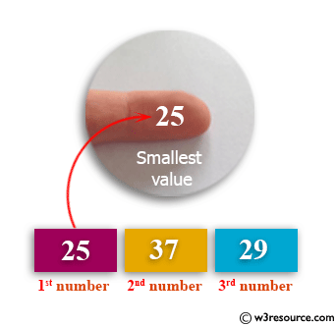
1. Write a Java method to find the smallest number among three numbers.
Test Data:
Input the first number: 25
Input the Second number: 37
Input the third number: 29
Expected Output:
The smallest value is 25.0

Slide 12
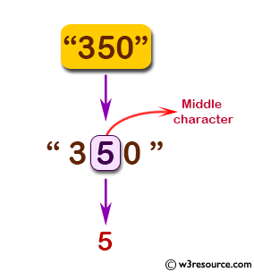
Write a Java method to display the middle character of a string.
Note: a) If the length of the string is odd there will be two middle characters.
b) If the length of the string is even there will be one middle character.
Test Data:
Input a string: 350
Expected Output:
The middle character in the string: 5

Slide 13
Write a Java method to count all vowels in a string.
Test Data:
Input the string: resource
Expected Output:
Number of Vowels in the string: 4

Slide 14
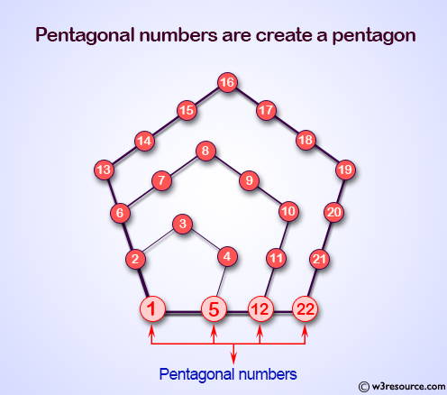
Write a Java method to display the first 50 pentagonal numbers. Go to the editor
Note: A pentagonal number is a figurate number that extends the concept of triangular and square numbers to the pentagon, but, unlike the first two, the patterns involved in the construction of pentagonal numbers are not rotationally symmetrical.
Expected Output:
1 5 12 22 35 51 70 92 117 145
176 210 247 287 330 376 425 477 532 590
651 715 782 852 925 1001 1080 1162 1247 1335
1426 1520 1617 1717 1820 1926 2035 2147 2262 2380
2501 2625 2752 2882 3015 3151 3290 3432 3577 3725

